Slide 1
Notification Service System Design for Irembo
13 Oct 2020
Oladipo Oyekanmi

Slide 2
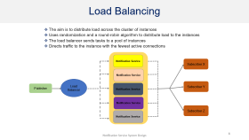
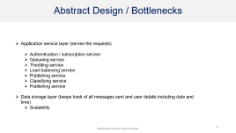
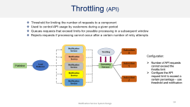
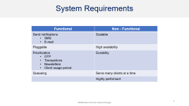
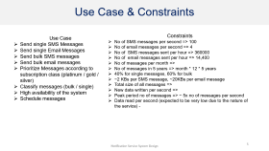
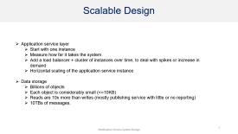
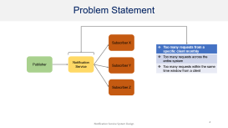
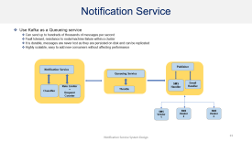
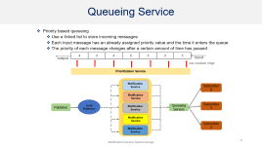
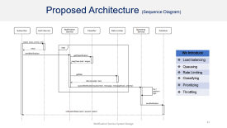
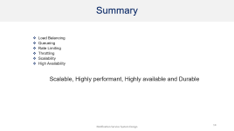
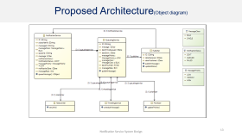
Outline

Slide 3
System Requirements
Functional | Non - Functional
Send notifications SMS E-mail | Scalable
Pluggable | High availability
Prioritization OTP Transactions Newsletters Client usage period | Durability
Queueing | Serve many clients at a time
 | Highly performant

Slide 4
Problem Statement
Subscriber X
Too many requests from a specific client monthly
Too many requests across the entire system
Too many requests within the same time window from a client
Publisher
Notification Service
Subscriber Y
Subscriber Z

Slide 5
Use Case & Constraints
Use Case
Send single SMS Messages
Send single Email Messages
Send bulk SMS messages
Send bulk email messages
Prioritize Messages according to subscription class (platinum / gold / silver)
Classify messages (bulk / single)
High availability of the system
Schedule messages
Constraints
No of SMS messages per second => 100
No of email messages per second => 4
No of SMS messages sent per hour => 360000
No of email messages sent per hour => 14,400
No of messages per month =>
No of messages in 5 years => month * 12 * 5 years
40% for single messages, 60% for bulk
~2 KBs per SMS message, ~20KBs per email message
Total size of all messages =>
New data written per second =>
Peak period no of messages => ~ 5x no of messages per second
Data read per second (expected to be very low due to the nature of the service) -

Slide 6
Abstract Design / Bottlenecks
Application service layer (serves the requests)
Authentication / subscription service
Queueing service
Throttling service
Load balancing service
Publishing service
Classifying service
Publishing service
Data storage layer (keeps track of all messages sent and user details including date and time)
Scalability

Slide 7
Scalable Design
Application service layer
Start with one instance
Measure how far it takes the system
Add a load balancer + cluster of instances over time, to deal with spikes or increase in demand
Horizontal scaling of the application service instance
Data storage
Billions of objects
Each object is considerably small (<=10KB)
Reads are 10x more than writes (mostly publishing service with little or no reporting)
10TBs of messages,

Slide 8
Load Balancing
The aim is to distribute load across the cluster of instances
Uses randomization and a round-robin algorithm to distribute load to the instances
The load balancer sends tasks to a pool of instances
Directs traffic to the instance with the fewest active connections
Notification Service
Subscriber X
Notification Service
Load Balancer
Subscriber Y
Publisher
Notification Service
Notification Service
Subscriber Z
Notification Service

Slide 9
Queueing Service
Priority based queueing
Use a linked list to store incoming messages
Each input message has an already assigned priority value and the time it enters the queue
The priority of each message changes after a certain amount of time has passed
output
4 | 3 | 4 | 5 | 3 | 2 | 3
input
low / medium / high
Prioritization Service
Notification Service
Subscriber X
Notification Service
Load Balancer
Subscriber Y
Publisher
Notification Service
Queueing Service
Notification Service
Subscriber Z
Notification Service

Slide 10
Throttling (API)
Threshold for limiting the number of requests to a component
Used to control API usage by customers during a given period
Queues requests that exceed limits for possible processing in a subsequent window
Rejects requests if processing cannot occur after a certain number of retry attempts
Notification Service
Throttling
Subscriber X
Notification Service
Configuration:
Number of API requests cannot exceed the throttle limit
Configure the API request limit to exceed a certain percentage – use threshold and notification
Load Balancer
Subscriber Y
Publisher
Notification Service
Queueing Service
Notification Service
Subscriber Z
Notification Service

Slide 11
Notification Service
Use Kafka as a Queueing service
Can send up to hundreds of thousands of messages per second
Fault tolerant, resistance to node/machine failure within a cluster
It is durable, messages are never lost as they are persisted on disk and can be replicated
Highly scalable, easy to add new consumers without affecting performance
Notification Service
Publisher
Queueing Service
SMS Handler
Email Handler
Classifier
Rate Limiter
+
Request Counter
Throttle
SMS Vendor 1
SMS Vendor 2
SMS Vendor n

Slide 12
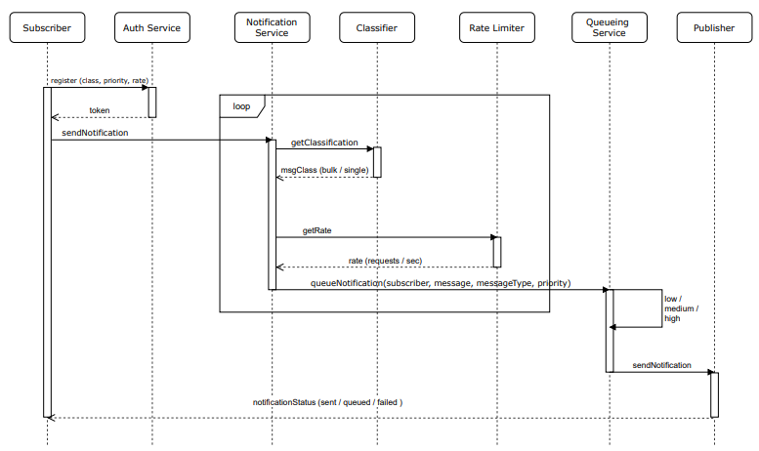
Proposed Architecture (Sequence Diagram)
We Introduce
Load balancing
Queueing
Rate Limiting
Classifying
Prioritizing
Throttling

Slide 13
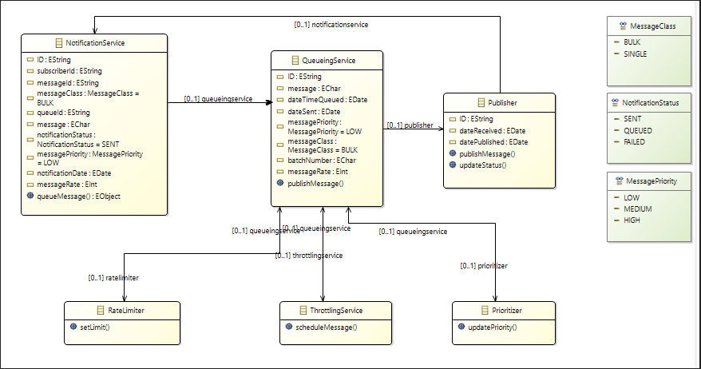
Proposed Architecture(Object diagram)

Slide 14
Summary
Load Balancing
Queueing
Rate Limiting
Throttling
Scalability
High Availability
Scalable, Highly performant, Highly available and Durable

